Slide 1
A MEMBER OF THE RUSSELL GROUP

Slide 2
Teaching to cure-teaching to care
SAAHE 2011
Potchefstroom
North West University
Innovation through diversity

Slide 3
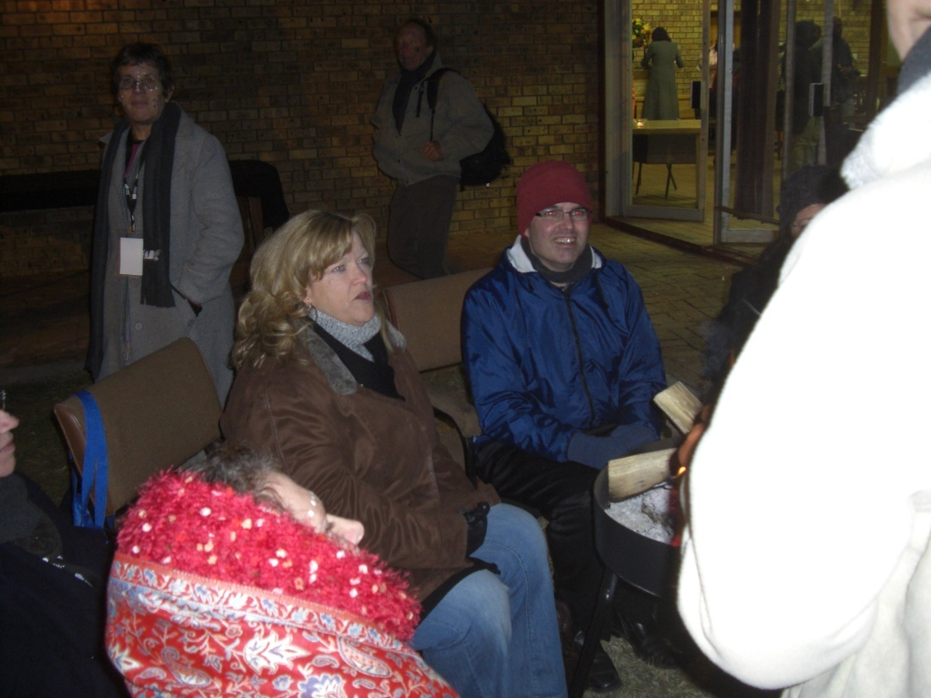
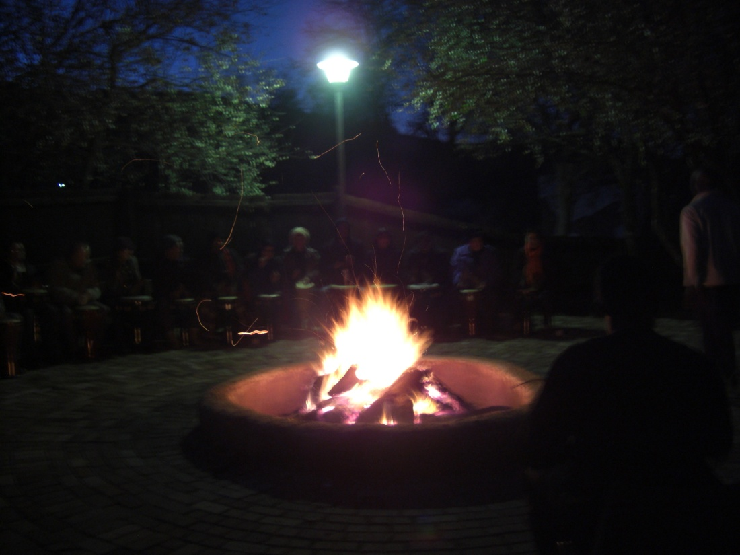
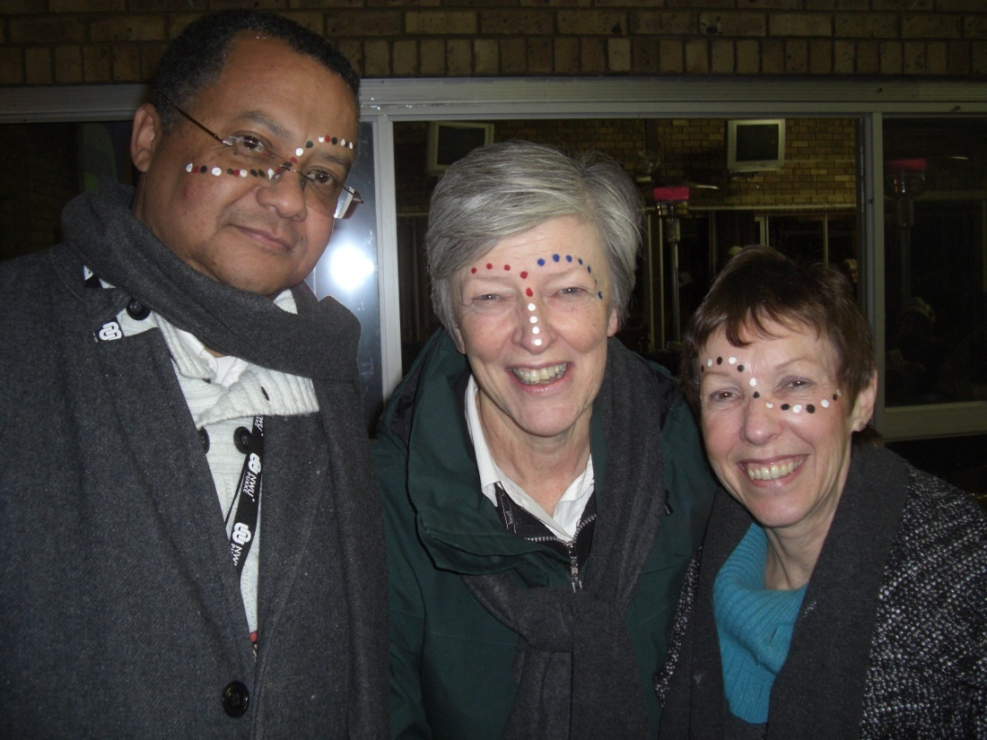

Slide 4
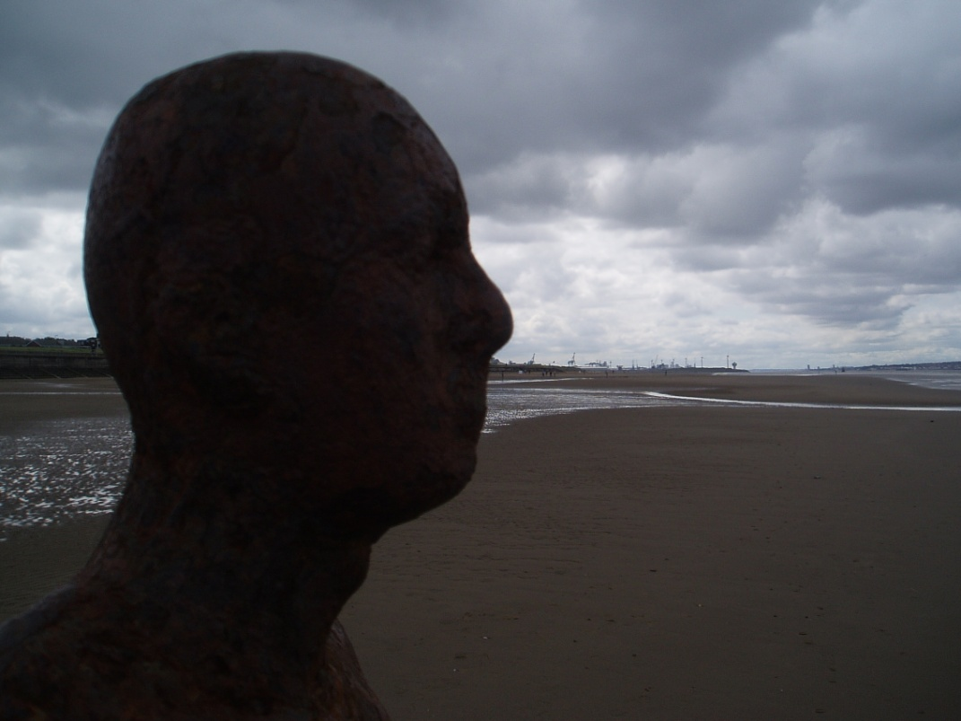
Making use of adult learning theories
David Taylor
School of Medicine

Slide 5
Adult learning theory
There are many, many theories
They are not all mutually exclusive
They each have something to recommend them

Slide 7
Instrumental Learning theories
Behaviourist theories
Stimulus-response. Skinner
Cognitive theories
Focuses on mental processes not behaviour. Piaget
Experiential learning
Behaviour in practice, Kolb

Slide 8
Humanistic Theories
Andragogy
Need, readiness, motivation. Knowles
Self-directed learning
(but what about social context?)
Transformative learning
Disorienting dilemma
Context
Critical reflection. Mezirow

Slide 9
Situated cognition
Learning and thinking are
social activities
structured by the tools available
dependent on the situation
Knowing is supported by doing
Wenger, Land

Slide 10
Motivation and reflection
Expectancy valence theory
Low expectation of success results in poor motivation to learn
Reflection-change models
Kolb

Slide 12
Three things
You need to recognise what you already know
You need to know how the new stuff fits in
Dialogue makes it easier

Slide 13
Kolb
Concrete experience
Observations and reflections
formalization of abstract concepts and generalisations
Testing of implications of concepts in new situations

Slide 14
The cycle is fine, but incomplete
Reflect
and observe
Develop new concepts
Experiment or
articulate
Existing knowledge
Start here

Slide 15
In the thinker – elaborate & refine
Elaboration
Refinement
Reflect
and observe
Develop new concepts
Experiment or
articulate
Existing knowledge

Slide 16
Elaborate and refine
Learner
Teacher
Think of many possible explanations or solutions to the case or problem.
Work out which are the most likely resources to refine the possibilities
Actively participate in the activity and experiences
Refine the information into a hypothesis
Ensure the relevant learning experiences are available – at the appropriate level for the learner

Slide 17
In the thinker - organise
Elaboration
Refinement
Reflect
and observe
Develop new concepts
Experiment or
articulate
Existing knowledge
Reflect
organise

Slide 18
Organisation
Learner
Teacher
Test and re-test the hypothesis
Organise the information into a “story” that makes sense to the learner
Provide advance organisers for the learners – structures upon which they can continue to build.
Encourage reflection in action

Slide 19
colleague/teacher/patient feedback
Elaboration
Refinement
Reflect
and observe
Develop new concepts
Experiment or
articulate
Existing knowledge
Start here
Feedback
Reflect
organise

Slide 20
Feedback
Learner
Teacher
Articulate the knowledge, skills or attitudes developed
Provide feedback to peers and staff
Reflection on the learning experience (in action and on action)
Accept, and if appropriate act upon feedback received
Provide feedback to the learner, formally or informally.

Slide 21
In the thinker - consolidate
Elaboration
Refinement
Reflect
and observe
Develop new concepts
Experiment or
articulate
Existing knowledge
Start here
Feedback
Reflect
Consolidate
Reflect
organise

Slide 22
Consolidation
Learner
Teacher
Reflection in the light of new knowledge
Reflection on the learning process
Evaluate personal responsibility for the learning
Development of knowledge, skills and attitudes
Provide opportunities for the learner to rehearse and/apply their new knowledge
Encourage reflection on action.

Slide 23
Programme considerations
Dissonance
Elaboration
Refinement
Reflect
and observe
Develop new concepts
Experiment or
articulate
Existing knowledge
Start here
Feedback
Reflect
Consolidate
Reflect
Organise

Slide 24
Dissonance
Learner
Teacher
Identify prior (base-line) knowledge, skills and attitudes
Recognise the unknown
Recognise personal development and learning needs
Participate in planning personal learning objectives and relevant experiences
Increase extrinsic motivation through appropriate tasks
Help learner to recognise internal motivation factors
Explore the learner’s prior knowledge and experiences
Help student to identify his/her learning needs and the relevance of each

Slide 25
Dissonance
Task
Resources
Motivation
Stage of Development
Learning style

Slide 26
Resources
Should be
appropriate and sufficient
and relate to the other quadrants

Slide 27
Dissonance
Task
Resources
Motivation
Stage of Development
Learning style

Slide 28
Stage of development (Perry)
Duality
........
Multiplicity

Slide 29
Dissonance
Task
Resources
Motivation
Stage of Development
Learning style

Slide 30
Learning style (Entwistle/Biggs)
Strategic
Surface
Deep
Back

Slide 31
Dissonance
Task
Resources
Motivation
Stage of Development
Learning style

Slide 32
Motivation
Intrinsic
Knowles

Slide 33
Knowles a
The need to know
Why do I need to know this?
The learners’ self-concept
I am responsible for my own learning
The role of the learners’ experiences
I have experiences which I value and you should respect

Slide 34
Knowles b
Readiness to learn
I need to learn, because my circumstances are changing
Orientation to learning
Learning will help me deal with the situation in which I find myself
Motivation
I learn because I want to

Slide 35
Motivation
Extrinsic
the programme
the community

Slide 36
Community of Practice
We don’t live or work in a vacuum
Everyone is part of the community
We only learn in community
We are developing as part of that community

Slide 37
Dissonance
Task
Resources
Motivation
Stage of Development
Learning style

Slide 38
Task
Should be
interesting, relevant and non-trivial
and relate into the other quadrants

Slide 39
Taylor and Hamdy 2012
Task
Resources
Motivation
Stage of Development
Learning style
Reflect
and observe
Develop new concepts
Experiment or
articulate
Existing knowledge
Dissonance
Elaboration
Refinement
Start here
Feedback
Reflect
Consolidate
Reflect
organise

